Slide 1
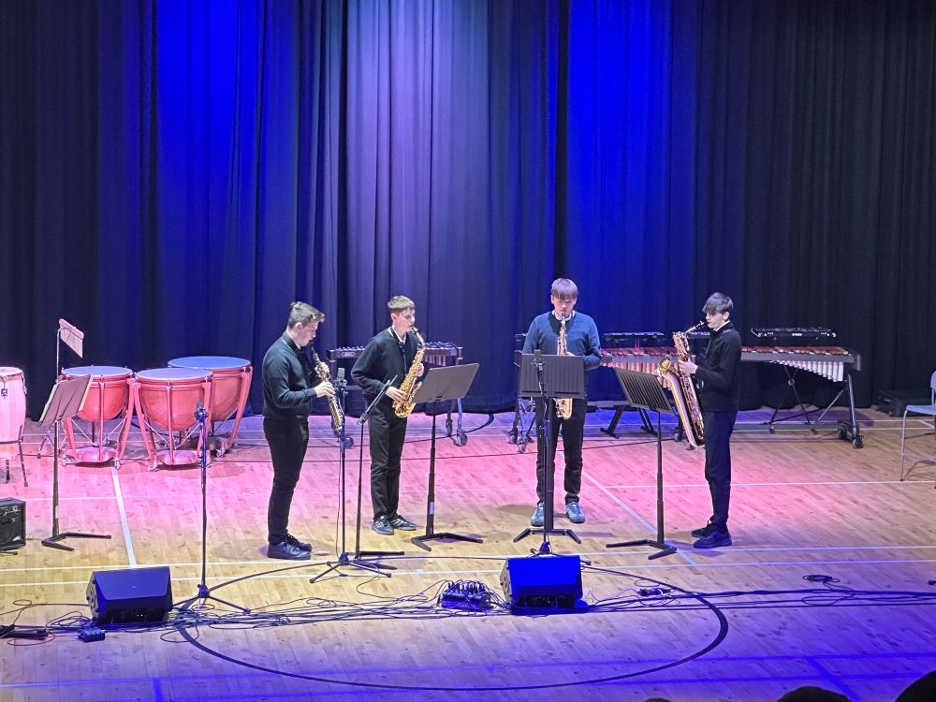
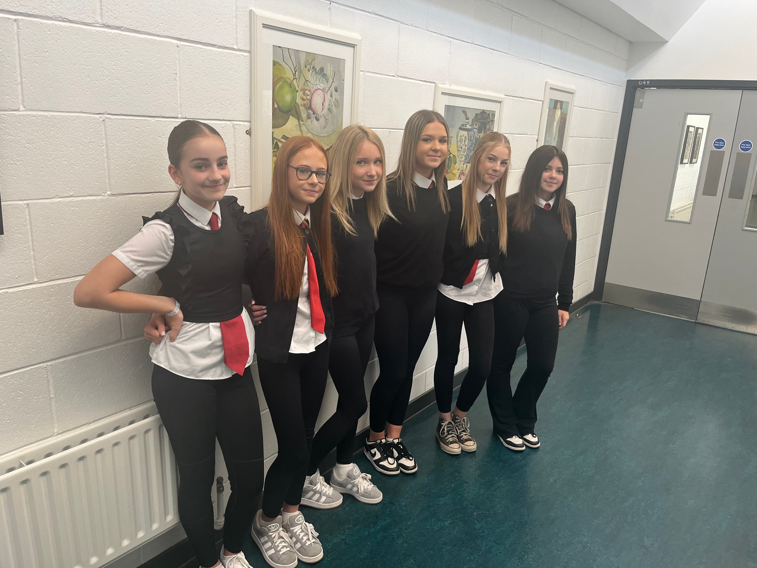
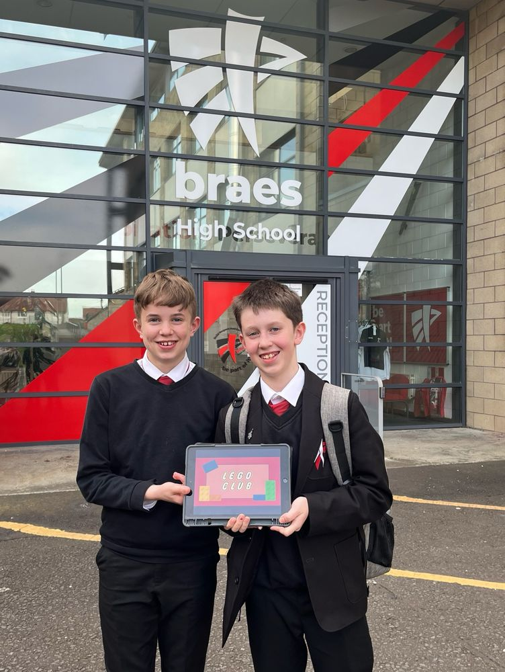
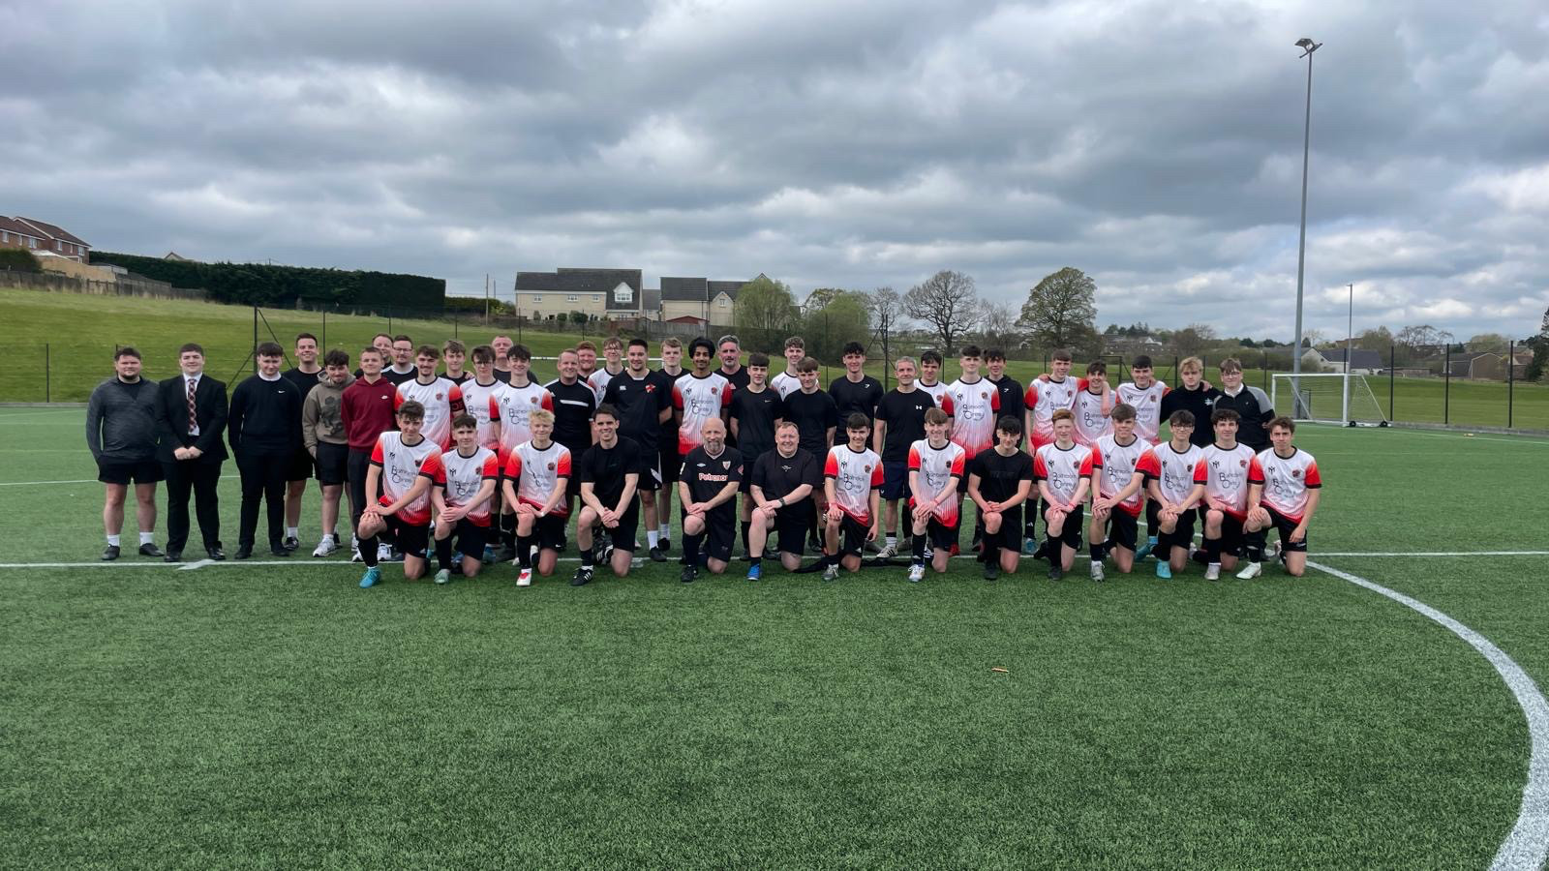
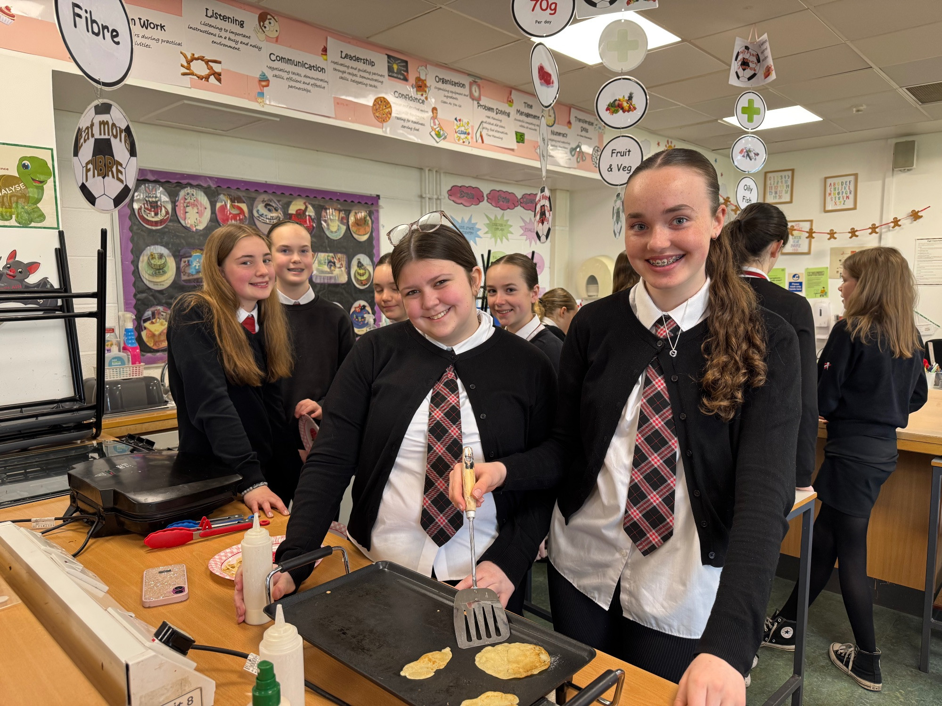
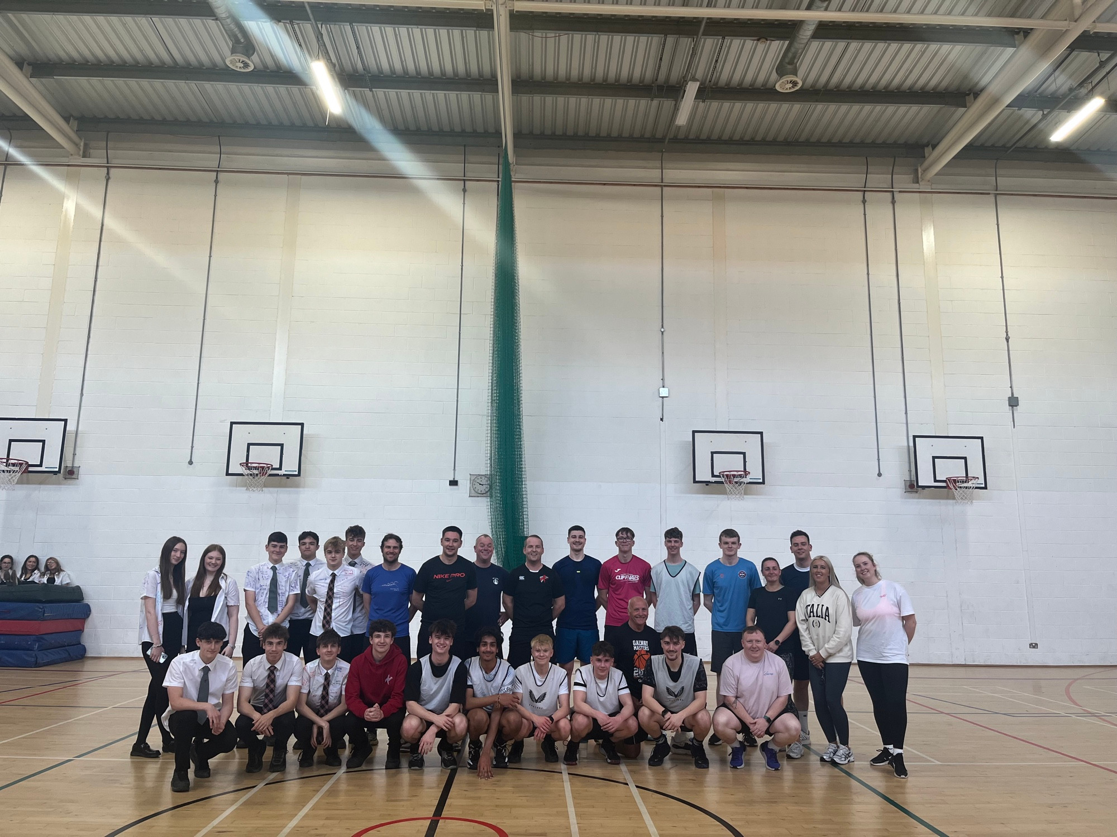



S4 and S5 Course Choice Process

Slide 2
What is a Course Choice Trawl?
It gives us an early indication of the courses pupils may wish to choose during the final course choice process in February 2026.
It allows us at an earlier stage to have informed discussions with pupils about pathways.
It is not the final course choice selection

Slide 3
How many courses do pupils in S5/6 study?
In S5/6 pupils will study:
Course 1 (5 periods) | Course 2 (5 periods) | Course 3 (5 periods) | Course 4 (5 periods) | Course 5 (5 periods) | Personal Development (3 periods) | Core PE (2 Periods) Core PSE (1 Period) Core RME (1 Period)

Slide 4
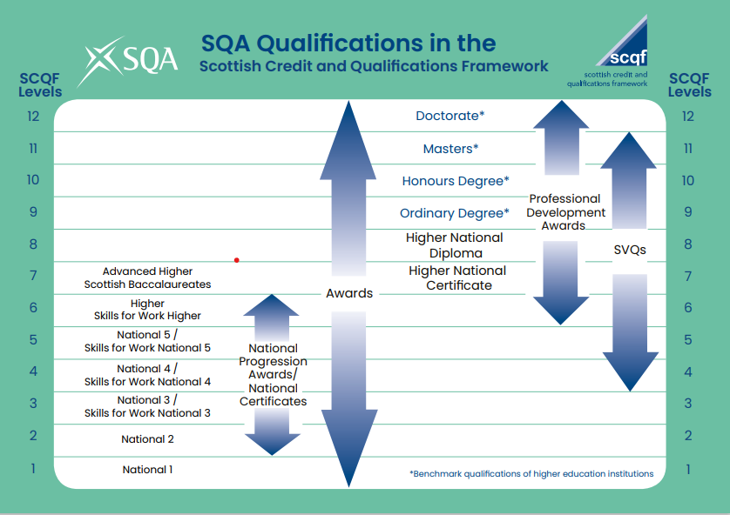

Slide 5
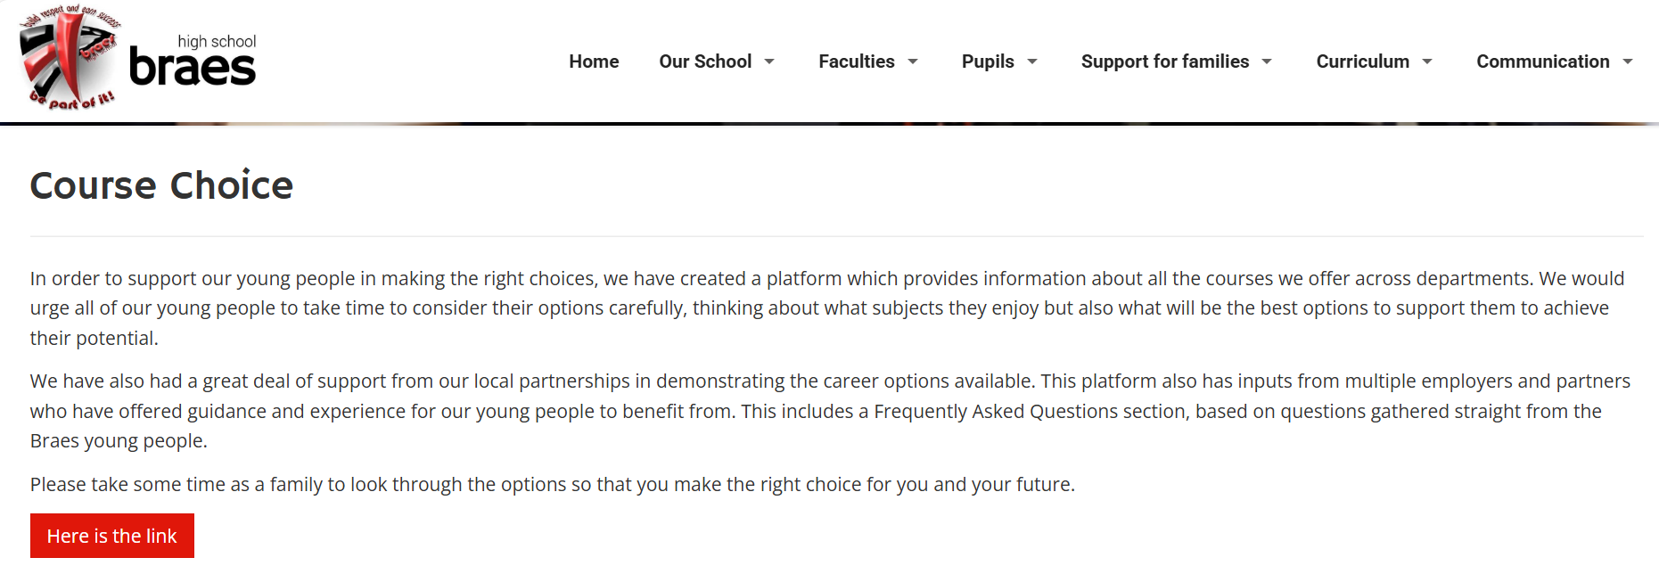
Course Information on our Website
Click Curriculum - Course Choice
Click Here is the link

Slide 6

Course Information on our Website
Click Subject Information

Slide 7
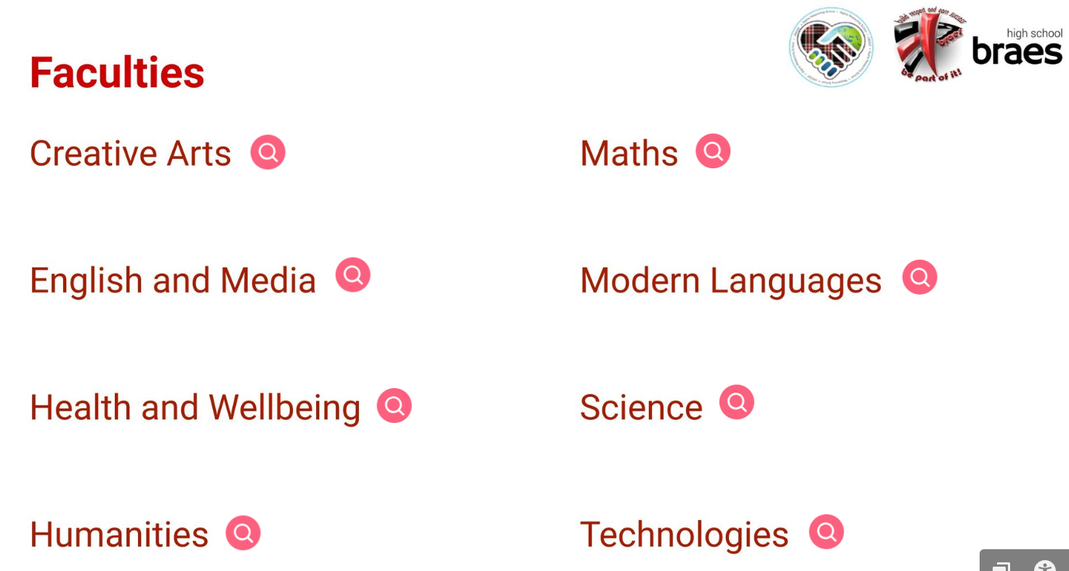
Course Information on our Website

Slide 8

Course Information on our Website
Course Outline
Assessment
Recommended Entry Requirements
Progression
Careers
Pupil Skills

Slide 9
Additional Learning Opportunities
1. School College Partnership Courses:
Course Name
Foundation Apprenticeship in Creative & Digital Media
NPA Level 5 Professional Cookery
NPA Level 4 Construction Craft & Technician
City and Guilds: Introduction to Hair & Beauty
Foundation Apprenticeship in Engineering
Skills for Work Early Education
2. Virtual Learning
3. Consortia Courses

Slide 10

What we have asked pupils to do: Seek Support and Advice
Consider:
What you think and know (what do you need?)
Support from home
Guidance from support staff, class teachers, Pastoral Heads, Faculty Heads, SLT, SDS
Use school website and other websites to support
Career and Course Choice Information Evening Wed 12th November
Complete course choice selection from 2nd February 2026 to 19th February 2026
Be Informed and Be Ambitious

Slide 11
What we will do:
Course Choice Trawl process
Career and Course Choice Information Evening
Classroom teacher/Faculty Head support
PSE lessons
One-to-one support from Pastoral Head
Grace Goodsir (SDS) grace.goodsir@sds.co.uk
Communicate additional supports
In-person Parents’ Evenings in February 2026
Be Informed and Be Ambitious

Slide 12
Additional support online:
Braes High School – Braes High School | Braes High School | Secondary School Falkirk | Falkirk Education
College/University websites. UCAS - https://www.ucas.com/
Apprenticeships.Scot https://www.apprenticeships.scot/
PlanItPlus:https:www.planitplus.net
My World of Work: https://www.myworldofwork.co.uk/option-choices
Young Scot:
https://young.scot/get-informed/where-could-your-school-subjects-take-you
Be Informed and Be Ambitious

Slide 13
